Slide 1
An Introduction to Artificial Intelligence and Machine Learning
By Bhagabat Prasad Behera

Slide 2
Agenda
AI/ML Introduction
ML vs Traditional Software
AI/ML Use cases
When to Use/Not to Use ML

Slide 3
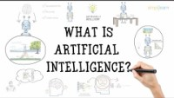
Source: Simplilearn

Slide 4
What are AI and ML?
Artificial intelligence is the capability of a computer system to mimic human cognitive functions such as learning and problem-solving. Through AI, a computer system uses maths and logic to simulate the reasoning that people use to learn from new information and make decisions.
Machine learning is an application of AI. It’s the process of using mathematical models of data to help a computer learn without direct instruction. This enables a computer system to continue learning and improving on its own, based on experience.

Slide 5

Traditional Software vs Machine Learning
Traditional Software
Data
Traditional Software
Answers
Rules
Machine Learning
Data
ML training
ML Inferencing
Inferred Answers
Rules
Unseen Data
Answers

Slide 6









ML Use Cases
Energy & Utilities
Power usage analytics
Smart grid management
Demand and supply optimization
Smart energy utilization
Energy & Utilities
House search and recommendation
Property management
Virtual tour
Site monitoring
Manufacturing
Predictive maintenance and monitoring
Demand forecasting
Defect detection
Process optimization
Retail
Predictive inventory planning
Recommendation engine
Customer life time value
Virtual try and buy
Financial Services
Risk analysis and regulation
Customer segmentation
Credit worthiness evaluation
Churn analytics
Healthcare & Life Sciences
Diagnostics based on real time patient data
Predictive health management
Healthcare service sentiment analysis
AI based medical image screening
Travel & Hospitality
Aircraft scheduling
Dynamic pricing
Traffic management
Intelligent travel assistants
Media & Entertainment
Content quality management
Content creation and moderation
Recommendations
Automated transcription and subtitles

Slide 7







AI Innovations
SlidesAI
Cogram takes automatic notes in virtual meetings and identifies action items, while keeping your data private and secure.
Compose AI is a Chrome extension that cuts your writing time by 40% with AI-powered autocompletion & text generation.
Easily create professional, engaging slides from any text in no time.
Transform your text instructions into Excel formulas in seconds with the help of AI
Write and edit lightning fast resume bullet points with cutting-edge ChatGPT
Grow your business with data-driven decisions. Go from data to AI in 10 minutes — no code or data science skills required.
QuillBot's AI-powered paraphrasing tool will enhance your writing
Turn text into memes using AI

Slide 8

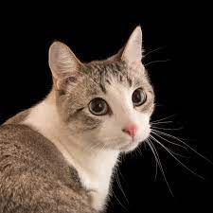


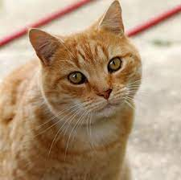


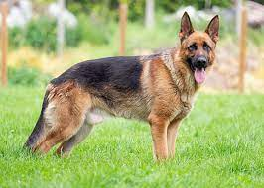
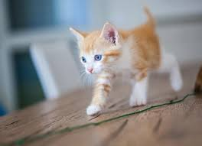
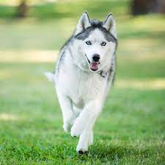
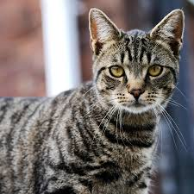
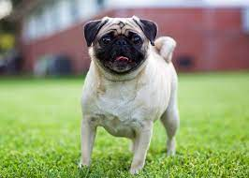
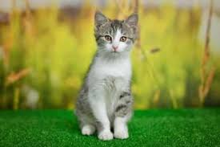
ML : How it works
Labelled Data
Data Analysis & Pre-processing
Model Training
Artefact
Inference
Predicted Labels
Dog
Cat
Data Cleaning
Dog
Model Training
Generate Prediction
Exploratory Data Analysis
Cat
Trained Model
Data Pre-processing
Unseen Data

Slide 9
When to use Machine Learning
Complex problem solving
Volume of data is large and growing fast
Personalized experience is needed
Some errors in the output result is accepted
Training data is of high quality
Studying the underlying pattern of the data

Slide 10
When to avoid Machine Learning
Rule based approach should be used
Data does not change often
Accuracy required 100%
Lack of good training data

Slide 11
Thank you!

